Slide 1
Technical words
Protocol :A Protocol is an agreement between the communicating parties on how communication is to proceed.
Peers: The entities comprising the corresponding layers on different machines are called peers.
Interface: Between each pair of adjacent layers is an interface. The interface defines which primitive operations and services the lower layer makes available to the upper one.
Network Architecture: A set of layers and protocols is called a network architecture.
Protocol stack: A list of protocols used by a certain system, one protocol per layer, is called a protocol stack.

Slide 2
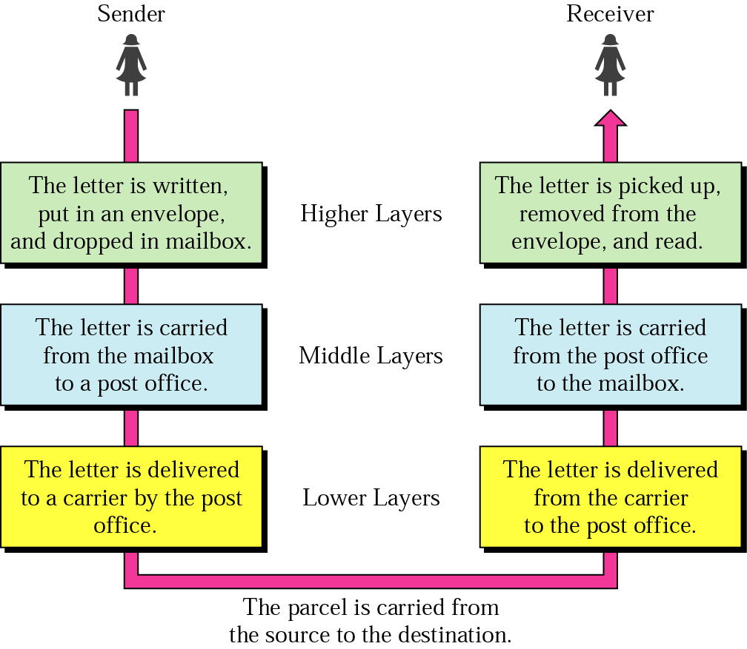
Layered Model: Sending a Letter
2-1

Slide 3
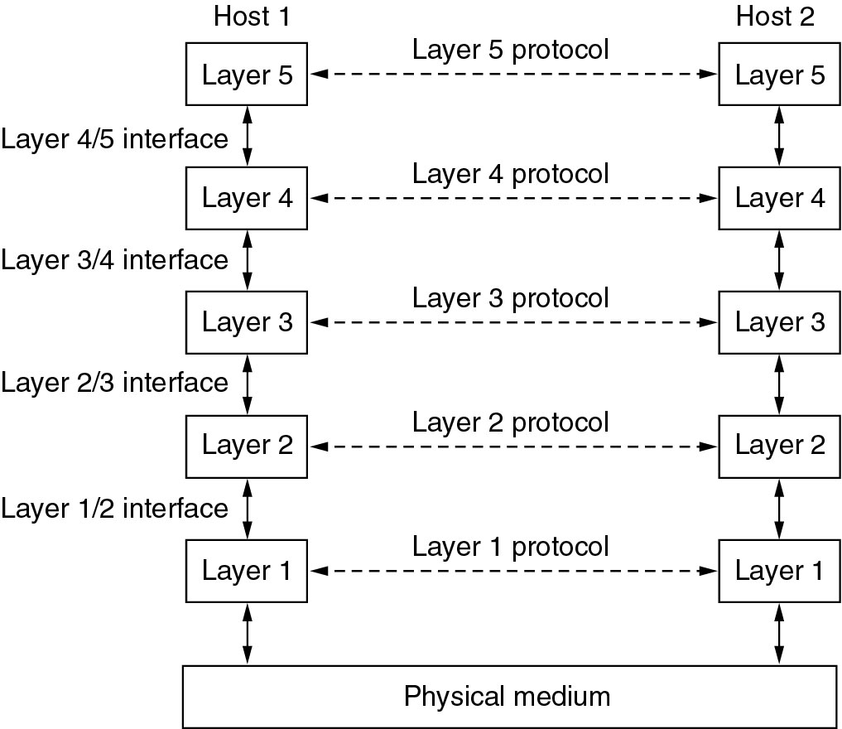
Network Software
Protocol Hierarchies
Layers, protocols, and interfaces.

Slide 4
Design Issues for the Layers
Addressing
Rules for data transfer
Error Control
Flow Control
Disassembly and Reassembly
Multiplexing
Routing

Slide 5
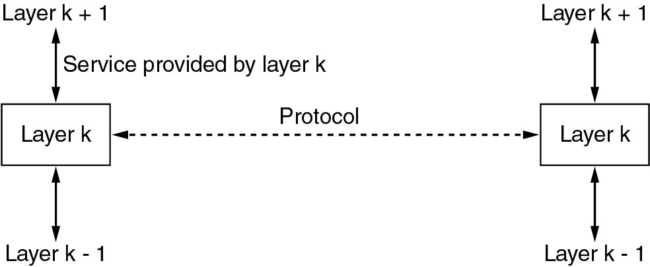
Services to Protocols Relationship
The relationship between a service and a protocol.

Slide 6
Reference Models
The OSI Reference Model
The TCP/IP Reference Model
A Comparison of OSI and TCP/IP
A Critique of the OSI Model and Protocols
A Critique of the TCP/IP Reference Model

Slide 7
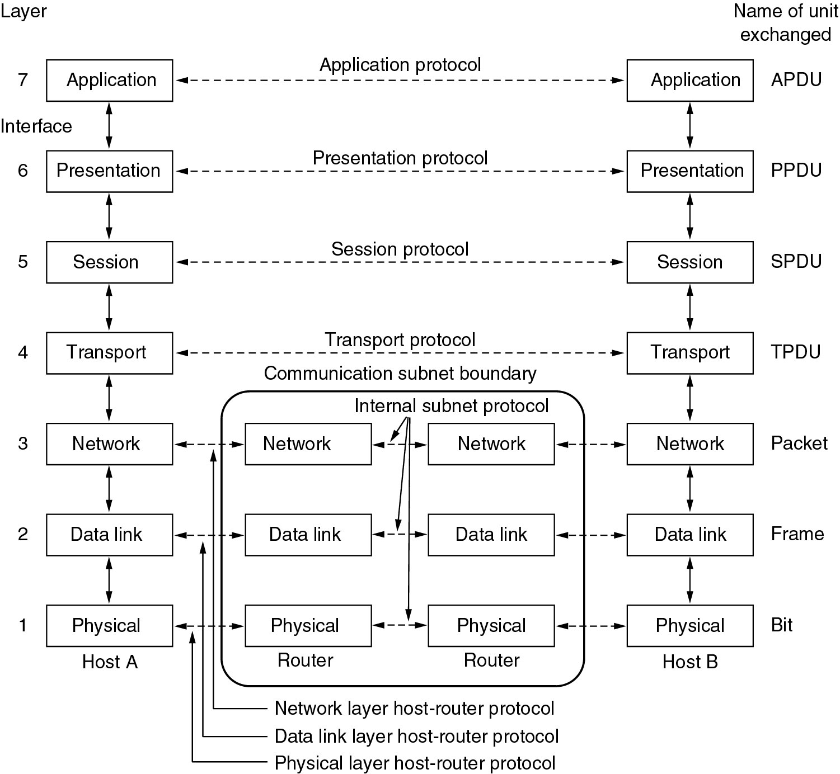
Reference Models
The OSI reference model.

Slide 8
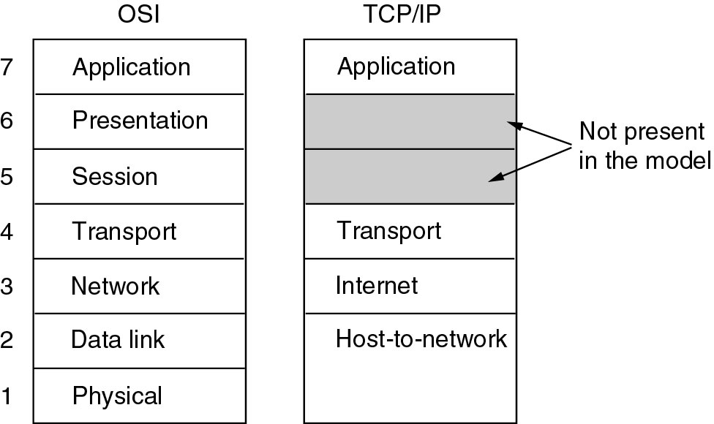
Reference Models (2)
The TCP/IP reference model.

Slide 9
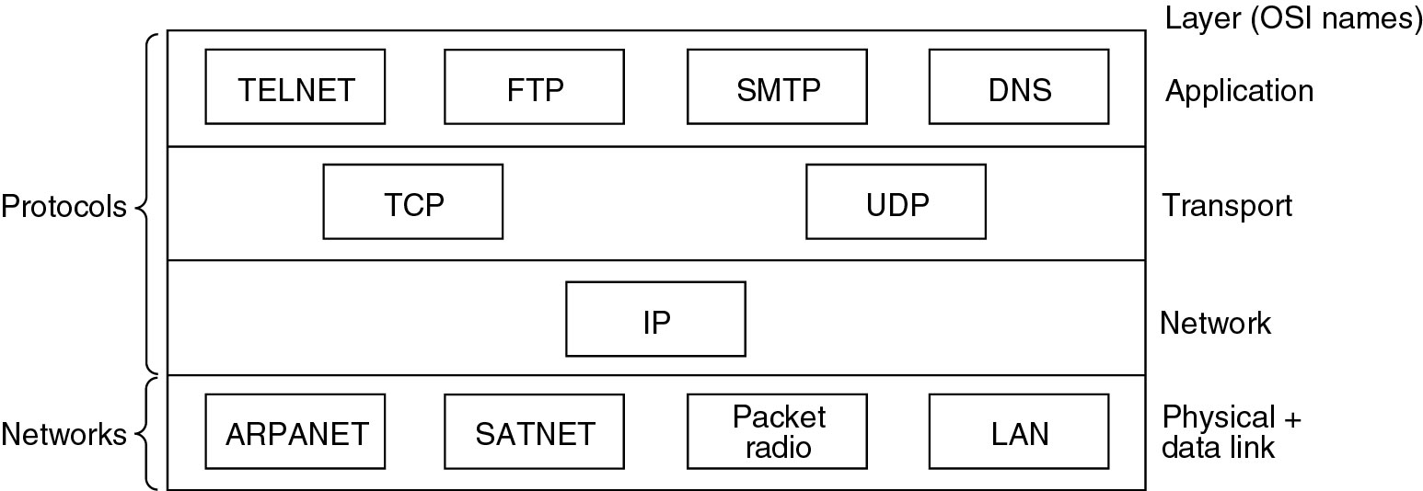
Reference Models (3)
Protocols and networks in the TCP/IP model initially.

Slide 10

OSI Model
ISO is the organization. OSI is the model
2-<number>

Slide 11

Interaction between layers in the OSI model
Layer and interface
2-<number>

Slide 12

An exchange using the OSI model
Encapsulation with header and possibly trailer
2-<number>

Slide 13

Physical Layer
The physical layer is responsible for movements of individual bits from one hop (node) to the next
Mechanical and electrical specification, the procedures and functions
2-<number>

Slide 14
Physical Layer: Duties
Physical characteristics of interfaces and media
Representation of bits
Data rate
Synchronization of bits
Line configuration
Physical topology
Transmission mode
2-<number>

Slide 15

Data Link Layer
The data link layer is responsible for moving frames from one hop (node) to the next
Transform the physical layer to a reliable (error-free) link
2-<number>

Slide 16
Data Link Layer: Duties
Framing
Physical addressing
Flow control
Error control
Access Control
2-<number>

Slide 17

Hop-to-Hop Delivery
2-<number>

Slide 18

Network Layer
The network layer is responsible for the delivery of packets from the source host to the destination host
2-<number>

Slide 19

Network Layer: Duties
Logical addressing and routing
2-<number>

Slide 20

Transport Layer
The transport layer is responsible for delivery of a message from one process to another
2-<number>

Slide 21
Transport Layer: Duties
Service-point (port) addressing
Segmentation and reassembly
Connection control
Flow control
Error control
2-<number>

Slide 22

Reliable Process-to-Process Delivery of a Message
2-<number>

Slide 23

Session Layer
Session layer is responsible for dialog control and synchronization
2-<number>

Slide 24

Presentation Layer
Presentation layer is responsible for translation, compression, and encryption
2-<number>

Slide 25

Application Layer
Application layer is responsible for providing services to the user
2-<number>

Slide 26
Application Layer: Services
Network virtual terminal: It allows a user to log on to a remote host.
Mail services
File transfer, access, and management
Directory services: provides distributed database sources and access for global information about various objects and services.
2-<number>

Slide 27

Summary of Layers
2-<number>

Slide 28

TCP/IP and OSI Model
2-<number>

Slide 29
TCP/IP Protocol Suite
Host-to-network : Physical and data link layer
  No specific protocol
Network layer
  IP(Internet Protocl), ARP(Address Resolution Protocol), RARP(Reverse ARP), ICMP(Internet Control Message Protocol), IGMP(Internet Group Message Protocol)
Transport layer
  TCP(Transmission Control Protocol), UDP(User Datagram Protocl), SCTP(Stream Control Transmission Protocol),
Application Layer
  Combined session, presentation, and application layers
2-<number>

Slide 30
The physical layer

Slide 31
Physical Layer
The purpose of the physical layer is to transport a raw bit stream from one machine to another.
Various physical media can be used for the actual transmission.
Transmission Media:
Media are grouped into guided media and unguided media.
Guided media means waves are guided along solid medium.
Ex: copper wire, fiber optics.
Unguided media is a media doesn't use any physical connectors between the two devices communicating. Usually the transmission is send through the atmosphere.
Ex: radio waves, micro waves, Infrared waves

Slide 32

The physical layer and transmission Medium

Slide 33

Classes of transmission media

Slide 34
Guided Transmission Data
  Magnetic Media
  Twisted Pair
  Coaxial Cable
  Fiber Optics

Slide 35
Magnetic Media
One of the common way to transport data from one computer to another is to write them on to magnetic tape or removable media (DVD) physically transport the tape or DVD to the destination machine and read them.
The tape densities are increasing.
It is not suitable in applications, where on-line connection is needed

Slide 36
Twisted Pair
Oldest transmission media
A twisted pair consists of two insulated copper wires typically about 1mm thick. The wires are twisted together in a helical form.
Twisting reduces interference (two parallel wires constitute a simple antenna; a twisted pair does not.)
Cheap medium
Commonly used for communications within buildings and in telephone networks
For longer distance repeaters are needed.
Twisted pairs can be used for transmitting either analog or digital signals.
Produced in unshielded (UTP) and shielded (STP) forms, and in different performance categories.
Cables may hold hundreds of pairs. Neighbor pairs typically have different twist lengths to reduce crosstalk.
Category 5 has more twists per centimeter.

Slide 37
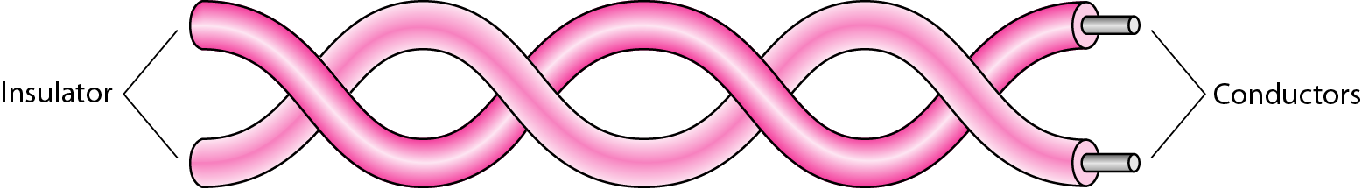
Twisted-pair cable

Slide 38
Twisted Pair
(a) Category 3 UTP.
(b) Category 5 UTP.

Slide 39

UTP and STP cables

Slide 40

Coaxial cable

Slide 41

Categories of coaxial cables

Slide 42
Fiber Optics
Optical Fiber
Three key components: light source, transmission system, and a detector
The detector generates an electric pulse when hit by light
1-a pulse of light; 0-missing pulse of light.
optical rays travel in ultra-thin fiber of glass
By attaching a light source to one end of an optical fiber and a detector to the other, we have a unidirectional data transmission system
accepts an electrical signal converts to light at sending side transmits light pulses and then reconverts the light pulses to an electrical signal at the receiving end.
A light ray incident at or above the critical angle is trapped inside the fiber.

Slide 43

Bending of light ray

Slide 44

Optical fiber

Slide 45
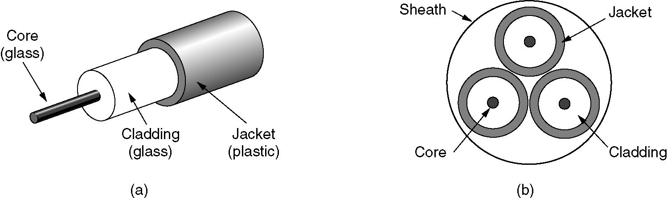
Fiber Cables
(a) Side view of a single fiber.
(b) End view of a sheath with three fibers.

Slide 46

Propagation modes

Slide 47

Modes

Slide 48
Wireless Transmission
The Electromagnetic Spectrum
Radio Transmission
Microwave Transmission
Infrared and Millimeter Waves
Lightwave Transmission

Slide 49

Wireless transmission waves

Slide 50
Wireless transmission
Radio Transmission:
Radio waves are easy to generate, can travel long advances, and can penetrate buildings easily, so they are widely used for communication.
Radio waves are omni directional, meaning that they travel in all directions from the source.
At low frequencies, radio waves power falls off with distance from the source.

Slide 51

Propagation methods

Slide 52
Wireless transmission
Radio waves are used for multicast communications, such as radio and television, and paging systems.
Microwaves are used for uni-cast communication such as cellular telephones, satellite networks and wireless LANs.
Infrared signals can be used for short-range communication in a closed area using line-of-sight propagation.

Slide 53
Switching
A network is a set of connected devices. Whenever we have multiple devices, we have the problem of how to connect them to make one-to-one communication possible.
A better solution is switching. A switched network consists of a series of interlinked nodes, called switches. Switches are devices capable of creating temporary connections between two or more devices linked to the switch.

Slide 54
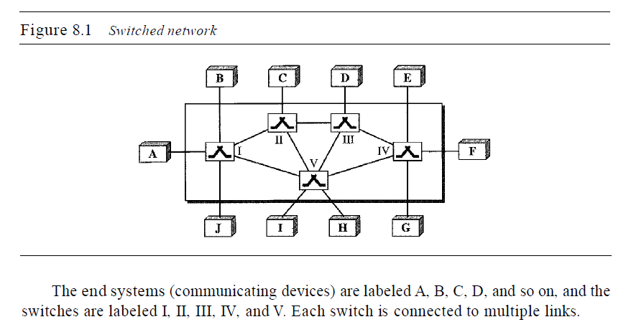
Switching

Slide 55
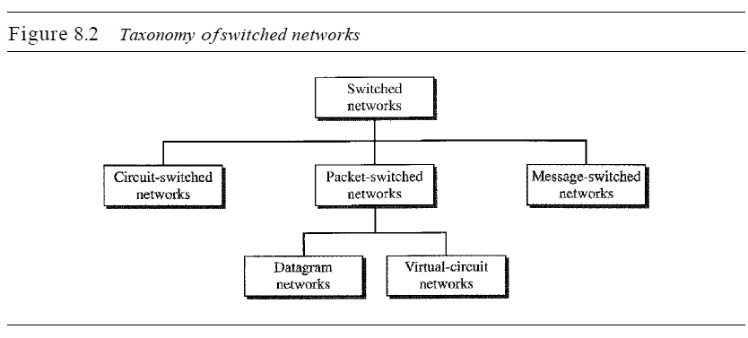
Switching

Slide 56
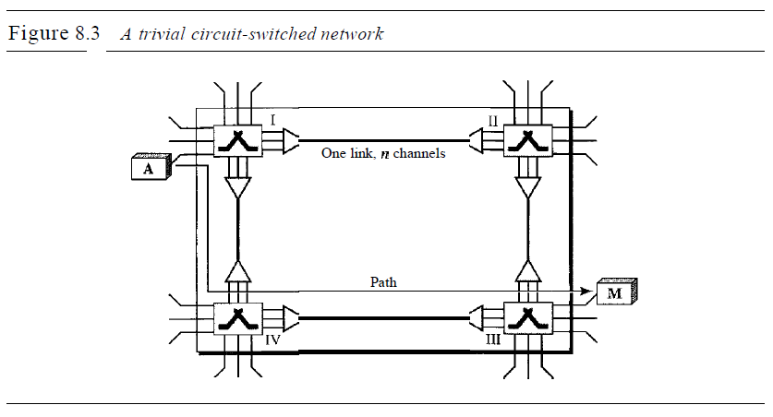
CIRCUIT-SWITCHED NETWORKS
A circuit-switched network is made of a set of switches connected by physical links, in which each link is divided into n channels.

Slide 57
CIRCUIT-SWITCHED NETWORKS
We need to emphasize several points here:
1. Circuit switching takes place at the physical layer.
2. Before starting communication, the stations must make a reservation for the resources to be used during the communication.
3. Data transferred between the two stations are not packetized (physical layer transfer of the signal). The data are a continuous flow sent by the source station and received by the destination station, although there may be periods of silence.
4.There is no addressing involved during data transfer. The switches route the data based on their occupied band (FDM) or time slot (TDM). Of course, there is end-to end addressing used during the setup phase.

Slide 58
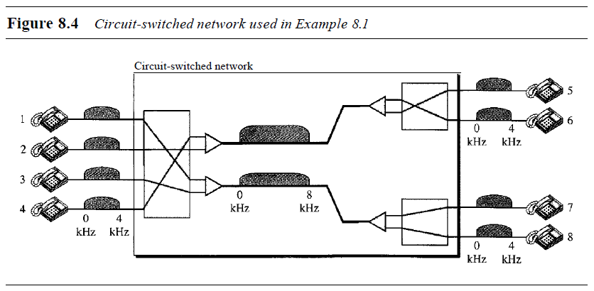
CIRCUIT-SWITCHED NETWORKS

Slide 59
packet-switched network
In packet switching, there is no resource allocation for a packet. This means that there is no reserved bandwidth on the links, and there is no scheduled processing time for each packet.
Resources are allocated on demand.
The allocation is done on a firstcome, first-served basis. When a switch receives a packet, no matter what is the source or destination, the packet must wait if there are other packets being processed.

Slide 60
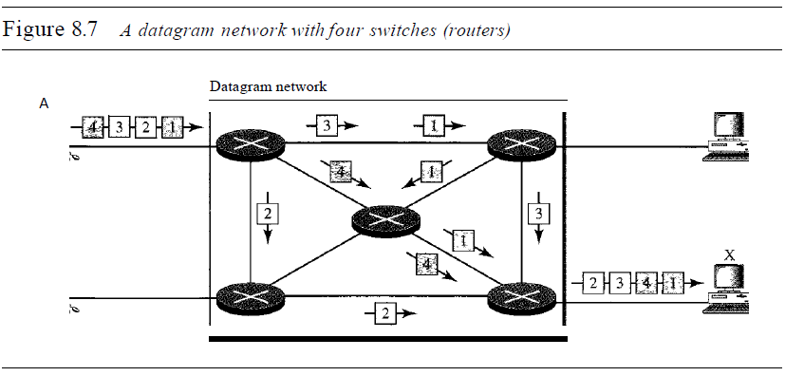
packet-switched network

Slide 61
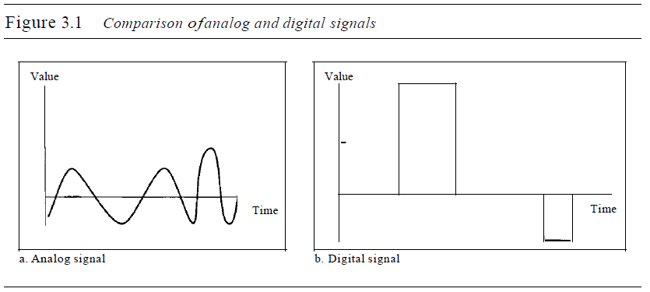
Analog and Digital signals
Data can be analog or digital.
The term analog data refers to information that is continuous.
digital data refers to information that has discrete states.

Slide 62
Analog signals
Periodic and Non-periodic Signals:
Both analog and digital signals can take one of two forms: periodic or nonperiodic .
A periodic signal completes a pattern within a measurable time frame, called a period, and repeats that pattern over subsequent identical periods. The completion of one full pattern is called a cycle.
A non-periodic signal changes without exhibiting a pattern or cycle that repeats over time.
Both analog and digital signals can be periodic or non-periodic.

Slide 63
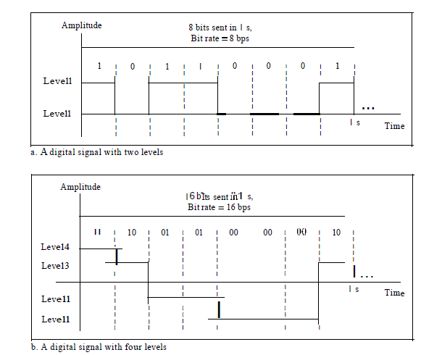
DIGITAL SIGNALS

Slide 64
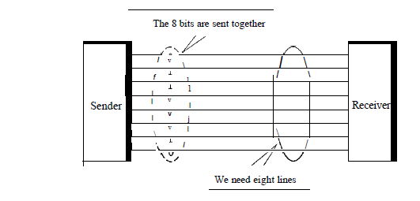
PARALLEL COMMUMNICATION

Slide 65
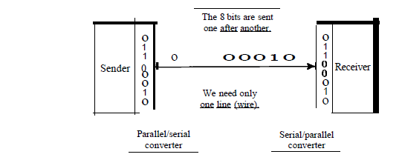
SERIAL COMMUNICATION

Slide 66
SERIAL COMMUNICATION

Slide 67
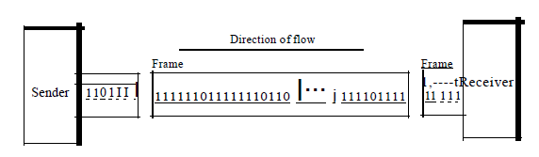
synchronous Transmission

Slide 68
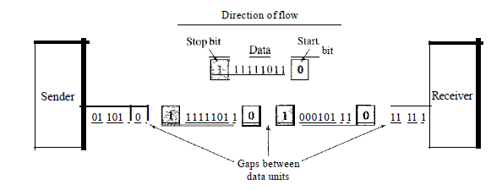
Asynchronous Transmission

